Slide 1
Capstone Engagement
Assessment, Analysis, and Hardening of a Vulnerable System

Slide 2
Table of Contents
This document contains the following sections:
01
Network Topology
02
Red Team: Security Assessment
03
Blue Team: Log Analysis and Attack Characterization
Hardening: Proposed Alarms and Mitigation Strategies
04

Slide 3
Network Topology
‹#›

Slide 4
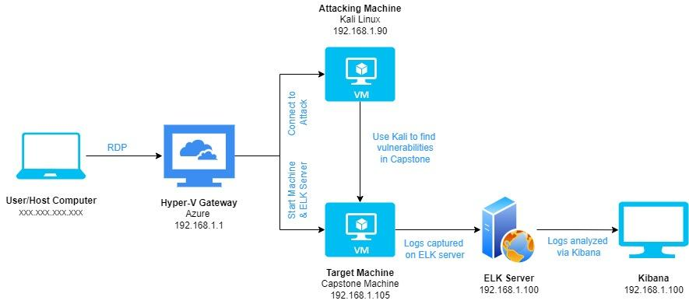
Network Topology
Network
Address Range: 192.168.1.0/24
Netmask: 255.255.240.0
Gateway: 10.0.0.1
Machines
IPv4: 192.168.1.1
OS: Windows 10
Hostname: Hyper-V
IPv4: 192.168.1.90
OS: Linux
Hostname: Kali
IPv4: 192.168.1.105
OS: Linux
Hostname: Capstone
IPv4: 192.168.1.100
OS: Linux
Hostname: ELK Server

Slide 5

Red Team
Security Assessment
‹#›

Slide 6
Recon: Describing the Target
Nmap identified the following hosts on the network:
Hostname | IP Address | Role on Network
Azure Hyper-V Machine | 192.168.1.1 | Host machine connecting all three virtual machines
Kali | 192.168.1.90 | Attacking machine used for the red team
Capstone | 192.168.1.105 | Target machine that represents a vulnerable server
ELK | 192.168.1.100 | Monitoring machine for Capstone and used by the blue team to monitor with Kibana

Slide 7
Vulnerability Assessment
The assessment uncovered the following critical vulnerabilities in the target:
Vulnerability | Description | Impact
Open Port 80 CVE-2019-6579 | Open port 80 or 443 where an attacker can execute administrative commands. | Allows the attacker to access and read sensitive/secret files and folders.
Weak Password/Brute Force CVE-2019-3746 | Attacker can use multiple username & password combination attempts usually from a wordlist with weak/common usernames & passwords. | Allows easy access to system due to simple passwords using wordlist with programs like Hydra or John the Ripper.
Hashed Password | Commonly used hashes or non-encrypted (salt) hashes can be looked up with cracking tools or even just Googled. | Allows the attacker an easy work around to get the password and then access to the system files.
WebDav Exploit | Extensions on HTTP that can be used to work directly with the server and open access to shells. | Allows attackers to potentially modify website content remotely and allow greater access for the attacker.

Slide 8
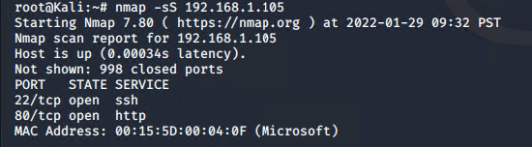
Exploitation: Open Port 80 Vulnerability
01
02
03
Tools & Processes
An Nmap scan was conducted on the Capstone machine to look for open ports.
Achievements
This found two open ports were found 80 and 22. These could be possible vulnerabilities in the machine that could be exploited
Example
Screenshot of Nmap scan below targeting just the Capstone machine and detecting the open ports.

Slide 9
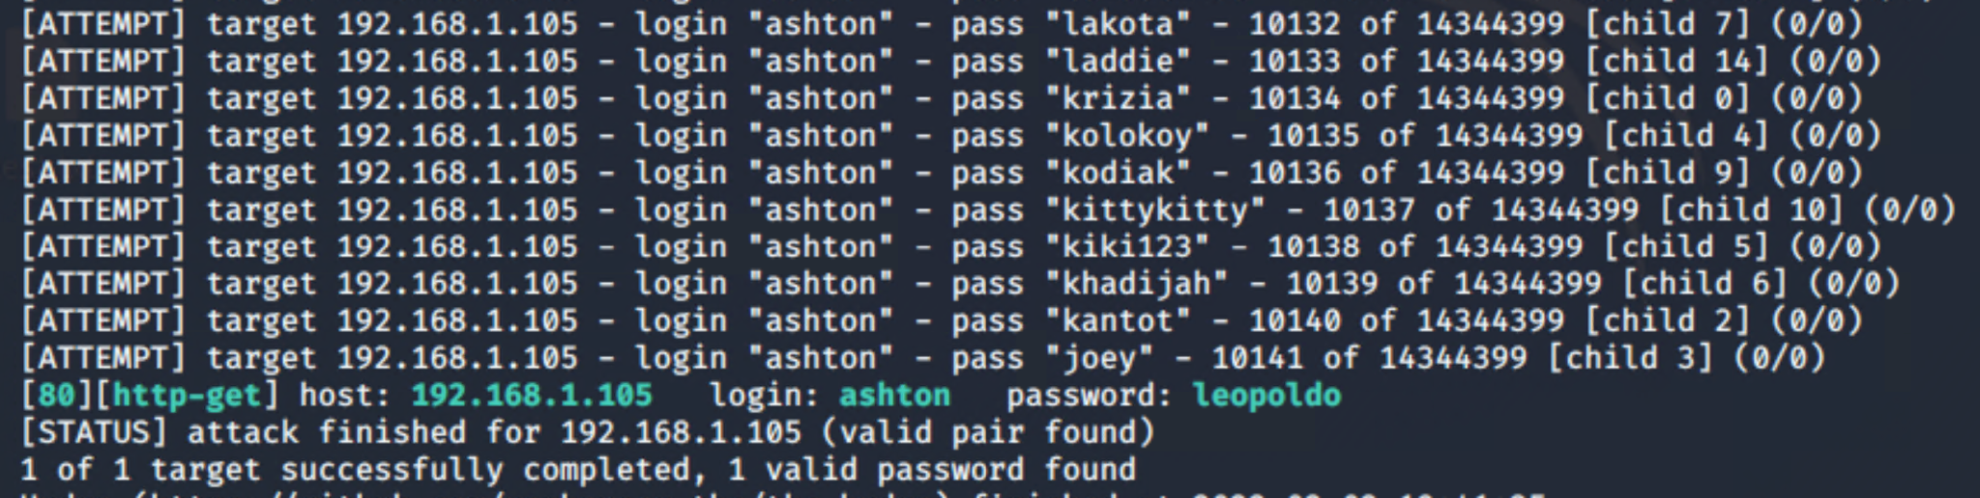
Exploitation: Brute Force of Password
01
02
03
Tools & Processes
Used the Brute Force tool Hydra with the wordlist rockyou.txt with common passwords and passed them through user Ashton.
Achievements
The password cracker allowed access to a secert_folder with sensitive information.
Example
Screenshot of Hydra command results below form the command: Hydra -l ashton -P /usr/share/wordlist/rockyou.txt -s 80 -f -vV 192.168.1.105 http-get /company_folder/secret_folder

Slide 10
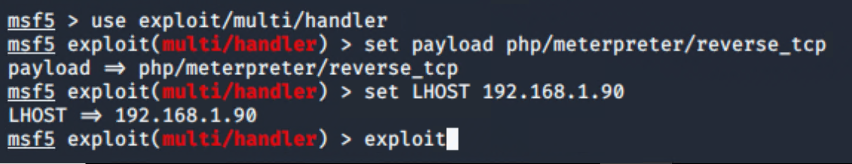
Exploitation: Local File Inclusion (LFI) Vulnerability
01
02
03
Tools & Processes
Uploaded a payload on to the Capstone machine using msfvenom and meterpreter and the multi/handler exploit.
Achievements
The exploit allowed for the establishment of a remote shell on the Capstone machine with root privilege and access to all file and directories.
Example
Screenshot of meterpreter using the multi/handler exploit to access the Capstone machine.

Slide 11

Blue Team
Log Analysis and Attack Characterization
‹#›

Slide 12
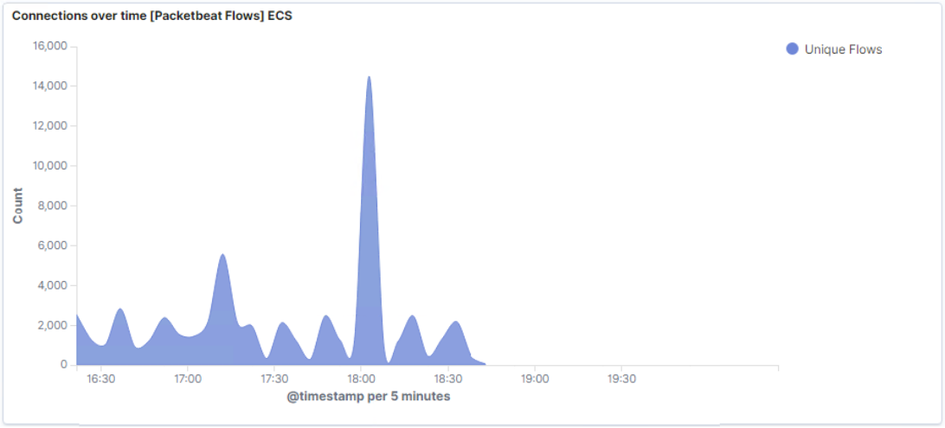

Analysis: Identifying the Port Scan
The port scan occurred around 1800 hours on January 29, 2021.
Around 14,513 packets were sent during the peak and the IP which it was sent from was 192.168.1.90
Based off the sudden peaks in the network traffic illustrate that this was a port scan.

Slide 13
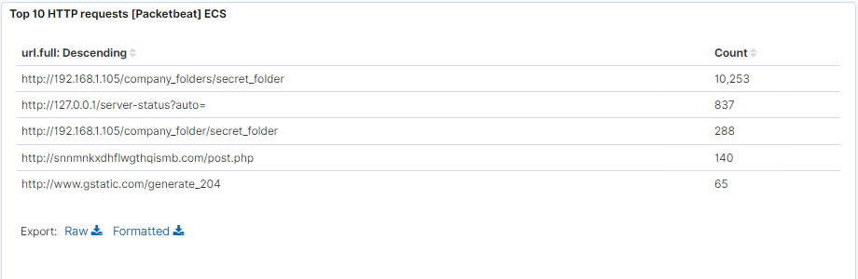
Analysis: Finding the Request for the Hidden Directory
The request for the hidden directory was at 1810 hours on January 29, 2021 and 10,253 requests were made.
The file that was requested was the secret_folder in the company_folders directory. This file contained a hash, that could be cracked, that had the password for another user's account (Ryan).

Slide 14
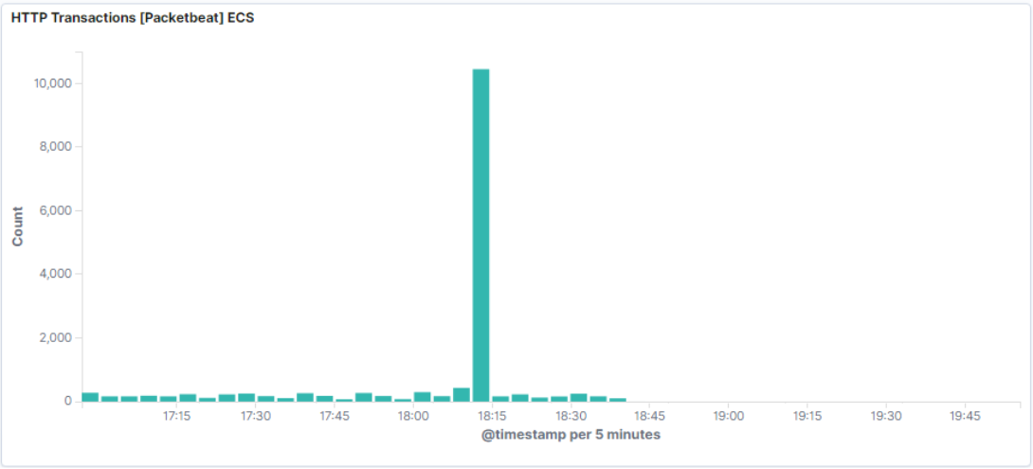
Analysis: Uncovering the Brute Force Attack
During the brute force attack, 10,447 requests were made.
Over 92% (about 9,642) of these requests were before the attacker discovered the password.

Slide 15
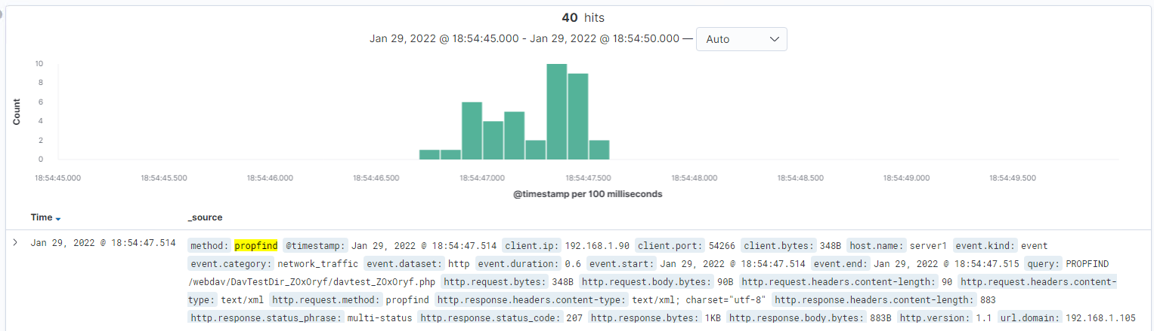
Analysis: Finding the WebDAV Connection
Looking for the WebDAV directory, 40 requests were made to this directory.
The files requested were propfind methods with various .php files that were used to establish a reverse shell.

Slide 16
Blue Team
Proposed Alarms and Mitigation Strategies
‹#›

Slide 17
Mitigation: Blocking the Port Scan
After this incident and the threat that port scans can pose, at the least, an alarm can be set to detect future port scans.
The alarm set would be to send an alert when a certain number of of request in a short window of time occurs, especially if they are from the same IP address.
The threshold for this alert would be to trigger when there are over 3000 request in a 30 minute window.
Further steps could be taken to harden the system besides sending an alarm.
These steps would include closing or blocking any unnecessary ports, installing firewalls that detect and stops scans, updating/keeping up-to-date with needed patches, and regularly run system port scans to detect open ports that might pose a threat.

Slide 18
Mitigation: Finding the Request for the Hidden Directory
Just like with the open port scans, alarms could be set for requests to access sensitive information, like in this case the hidden directory.
An alert could be set here too send a notice when a certain number of attempts have been placed to access the hidden directory.
Looking at the data, a threshold of 5 attempt within an hour could be placed to prevent these potential attacks.
This too can be further hardened in other ways besides just setting up notifications when a threshold is reached.
This could include removing hidden directories and secret files from the web server if they are not absolutely necessary,
Better encrypting the data that can be found in these directories and files, and also take more proactive approaches such blocking IP addresses that trigger the alarm to prevent future incidents.

Slide 19
Mitigation: Preventing Brute Force Attacks
Since Brute Force Attacks can be a more common strategy, it would be a good thing to setup alarms for these to help address potential attacks.
The alarm for this case could also be an alert that is triggered when invalid credentials have been entered on the web server. This type of issue is associated with the error type 401 for HTTP, and would be the trigger in the alarm.
The threshold for this would be to send out an alert for 10 errors being returned within 30 minutes.
There are several other methods to help deal with brute force attacks and to help mitigate them altogether.
These methods for hardening could include limiting the number of password attempts before locking out the system, requiring more complex passwords (specifically ones that would be on a common wordlists), requiring users to change passwords over a set amount of time, blocking IP addresses that continually have unsuccessful attempt and are not associate with a known user, and finally, block certain user agents known to be used in brute force attempts (in this case Hydra would be an example).

Slide 20
Mitigation: Detecting the WebDAV Connection
Since there were problems caused by WebDAV an alarm relating to this should be setup as well.
The alarm for this could be set up by having an alert be sent when unusual or less common HTTP methods are detected/used. This would help because WebDAV adds other HTTP methods such as propfind which was used to help detect this connection.
The threshold set for this would include making a list of the commonly used HTTP methods and any ones not on that list an alert would be sent out when one appears.
Other setting up alarms for less common HTTP methods, there are a couple of other ways to harden against WebDAV.
One of these would include setting up firewalls to detect and block these methods or machines using these methods.
Another way would include generating a whitelist of trusted IPs that need to use any of these methods or even prevent the access to the WebDAV folder to just these IP’s with clearance.

Slide 21
Mitigation: Identifying Reverse Shell Uploads
In the case of identifying reverse shell uploads, two possible alarms could be set.
One of these could be an alert that is sent when a other ports are used that are typically not intended to be used or common ports that are used with reverse shells, such as port 4444.
Another alarm that could be used is having an alert be sent out when files have been upload to the server. This can be done if files are not needed to be uploaded there or if permission to do so hasn't been granted.
Just like with the previous things mentioned, further hardening can be done here as well.
This could include doing port scans for other ones that are not intended to be open, by generating a whitelist with clearance to only a select few that can upload files onto the web server, and setup restrictions to block file uploads to this server over web interface

